Slide 1
Data Management for Dynamic Multimedia Analytics and Retrieval
PhD Defense
Ralph Gasser <ralph.gasser@unibas.ch> Databases and Information Systems (DBIS) Group, Department of Mathematics and Computer Science, University of Basel
Basel, 28th November 2022

Slide 2

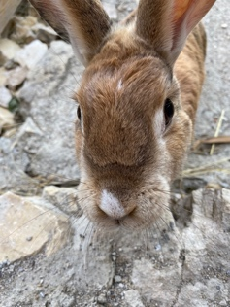
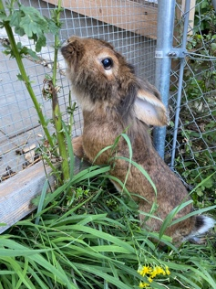
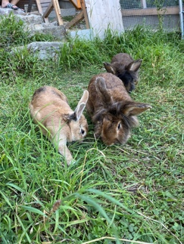
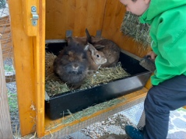





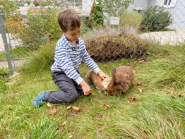
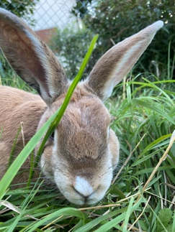
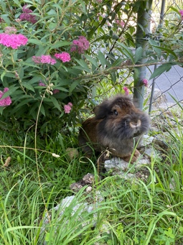
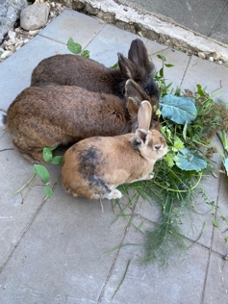


Motivation: Multimedia is Ubiquitous
Multimedia Retrieval
Social Media Analysis
Store
Store
Analyse
Search
Search
Multimedia
Database
Large and Mixed Data Collections
Low-frequency changes
Finding Items of Interest
Short-running queries (interactive)
Example
Private image collection
Collect Data Over Extended Time Period
High-frequency changes
Generating Insights
Short and long-running queries
Example
Trending Images on Twitter
Notes:
Multimedia is everywhere
Everyone has interacted with media in some form another in the last 24h
Multimedia Retrieval
e.g. private data collection
Social Media Analysis
e.g., trending images on Twitter

Slide 3


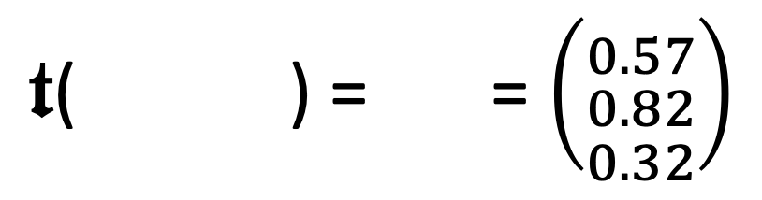
Working with Multimedia Data
Multimedia data is often unstructured (raw signal data)
→ Disconnect between data stored and information searched
We usually make multimedia data accessible by metadata
→ Technical metadata (e.g., resolution, geo references) → Textual descriptions / labels / annotations
→ Abstract features (e.g., salient colours)
Different types of metadata can be searched differently
→ Boolean retrieval (exact matches)
→ Similarity search (inexact matches)
rabbit
outdoors
bunny
Nutello
$𝖙$( ) = = $\left({0.57 \atop \begin{aligned}0.82 \\ 0.32\end{aligned}}\right)$
Feature transformation
$$𝕆→ 𝔽$$

Slide 4
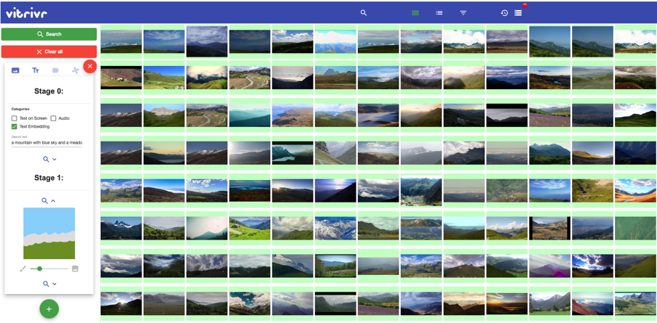




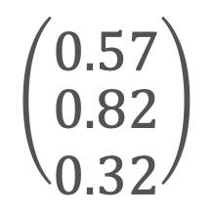
Role of Data Management in Multimedia Analytics
Interaction
Visualisation
Mapping
Data
Building
Visualization
Knowledge
Transformation
$$\left({0.57 \atop \begin{aligned}0.82 \\ 0.32\end{aligned}}\right)$$
outdoors
rabbit
Data Mining
bunny
Models
Refinement
Multimedia Database
Adapted from: Seebacher et al. (2017). Visual Analytics and Similarity Search: Concepts and Challenges for Retrieval Considering Users, Tasks, and Data
Keim et al. (2010). Mastering the information age: solving problems with visual analytics.
Notes:
Data
Transformed (e.g., features)
Forms foundation
Model
Analyses data (e.g., neural network, retrieval model)
Visualisation
Enables user interaction
Model refinement
Feedback loop
Insights

Slide 5
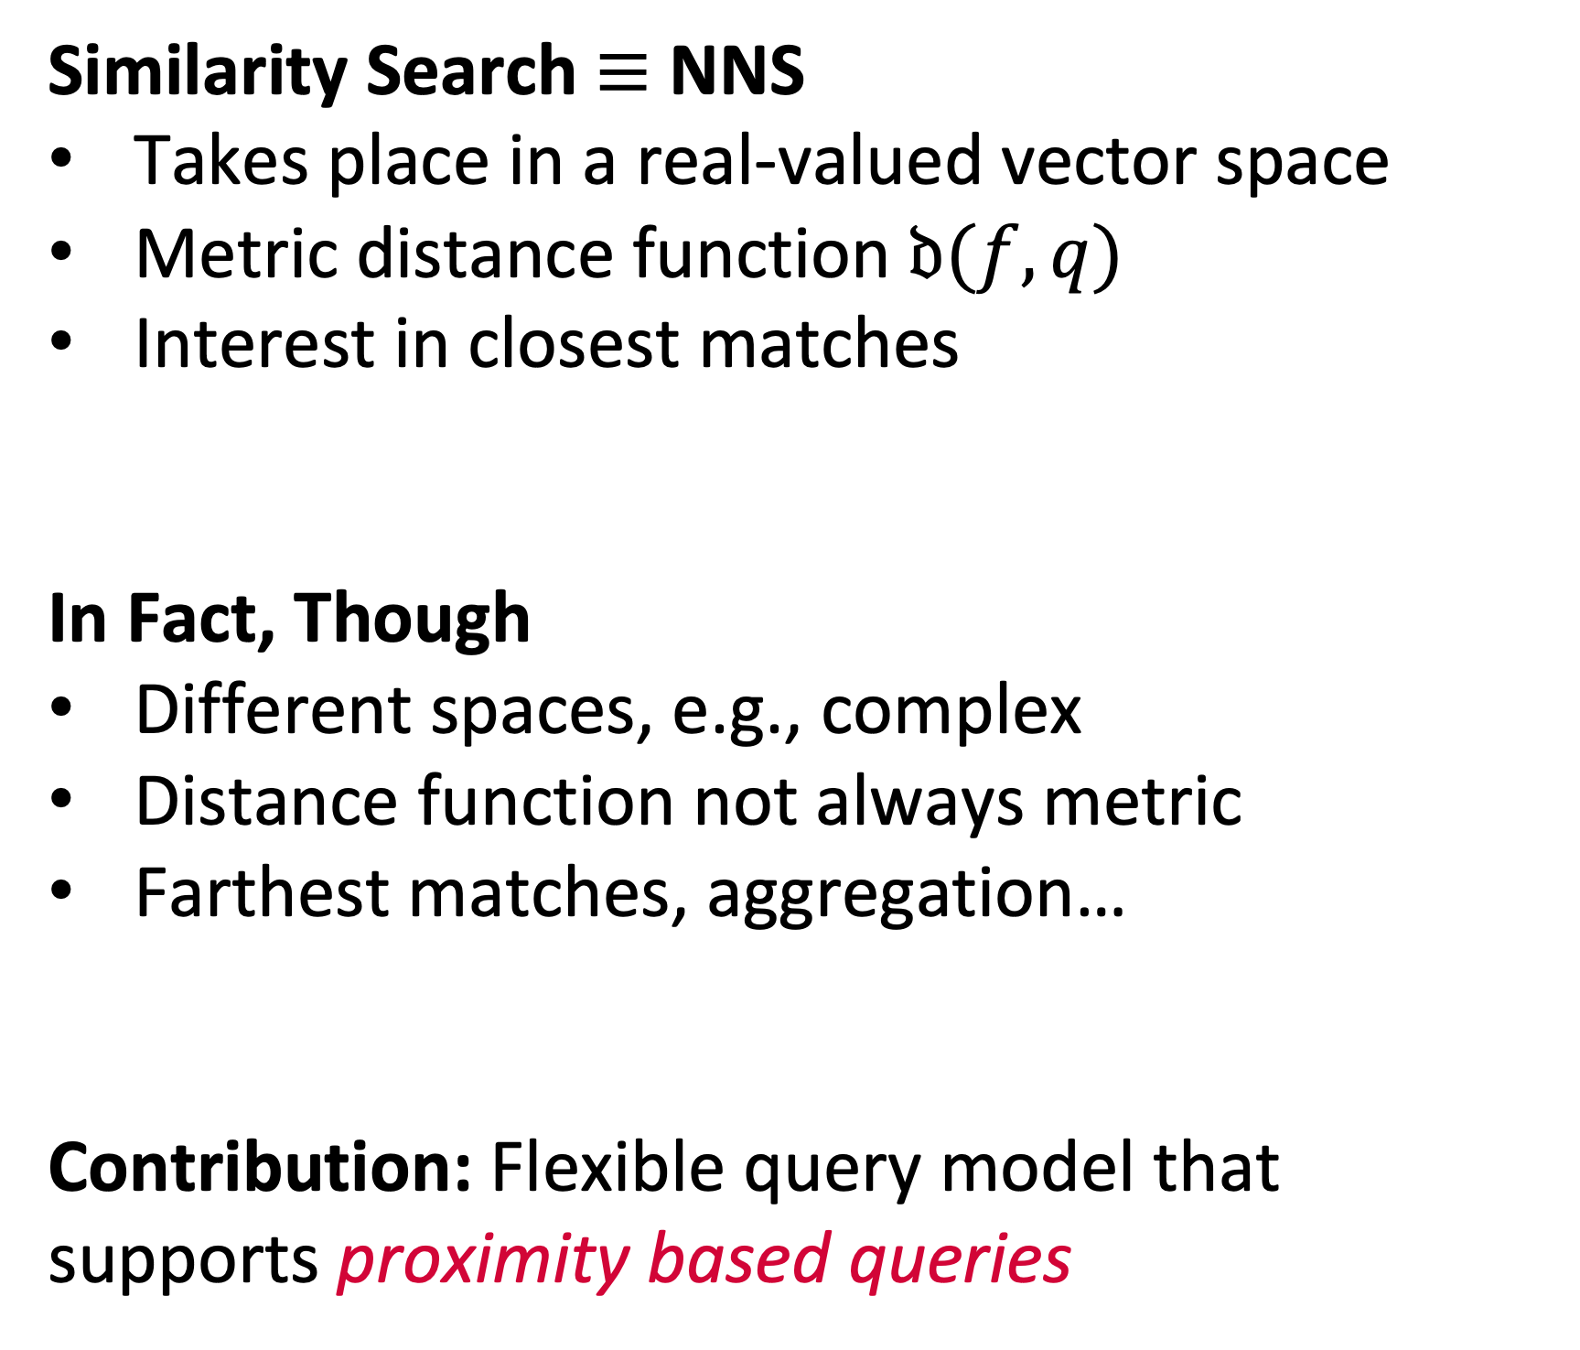


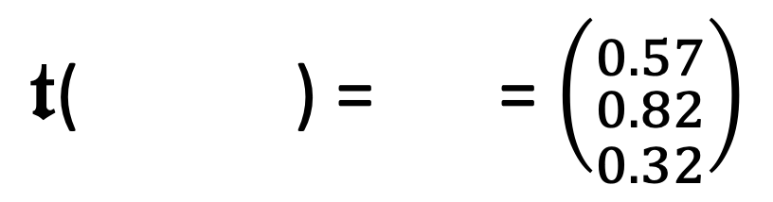

Challenging the Status Quo in Multimedia Data Management Assumption 1 / Similarity Search
$𝖙$( ) = = $\left({0.57 \atop \begin{aligned}0.82 \\ 0.32\end{aligned}}\right)$
Similarity Search $≡$ NNS
Takes place in a real-valued vector space
Metric distance function $𝔡(f,q)$
Interest in closest matches
In Fact, Though
Different spaces, e.g., complex
Distance function not always metric
Farthest matches, aggregation…
Contribution: Flexible query model that supports proximity based queries
green
Feature transformation
$$𝕆→ 𝔽$$
$$𝔡$$
Query
red
High-dimensional Vector Space $$𝔽⊂ℝ^{3}$$
blue
Salton et al. (1975). A Vector Space Model for Automatic Indexing.

Slide 6
Challenging the Status Quo in Multimedia Data Management Assumption 2 / Staticity of Data Collections
Data Collections Do Not Change
Offline vs. online phase (ingest vs. search)
No concurrent access to data
Index structures can be prepared
In Fact, Though
Data may be subject to change (e.g., social media analysis)
Concurrent writes and reads
High-Dimensional indexes must cope with changes
Contribution: System-level mechanisms to allow for incremental changes to indexes.
Retrieval System
Metadata
offline
Multimedia Database
online
Query
Results

Slide 7
Challenging the Status Quo in Multimedia Data Management Assumption 3 / Workloads Known in Advance
Pre-determined Workloads
System optimised for a type of workload
Only a matter of “parametrisation” (e.g., query vector, distance, index)
In Fact, Though
Query workloads may vary (exploration search axis [1])
Execution paths impact results (execution time vs. retrieval quality)
Applications allow for different trade-offs
Contribution: A planning approach to query execution (database selects execution path)
[1] Zahàlka et al. (2014). Towards Interactive, Intelligent and Integrated Multimedia Analytics

Slide 8
Contributions of this Thesis
A query model that integrates proximity based queries into the relational data model
→ Allow for composability and query planning.
A cost model that takes the expected and desired quality of results into account
Take quality into account during query planning
A storage-, write- and failure model for maintaining high-dimensional index structures
→ Support for incremental changes
A reference implementation called Cottontail DB using the aforementioned models
An evaluation demonstrating the effectiveness of both the models and the implementation

Slide 9
Contributions

Slide 10
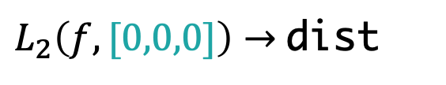
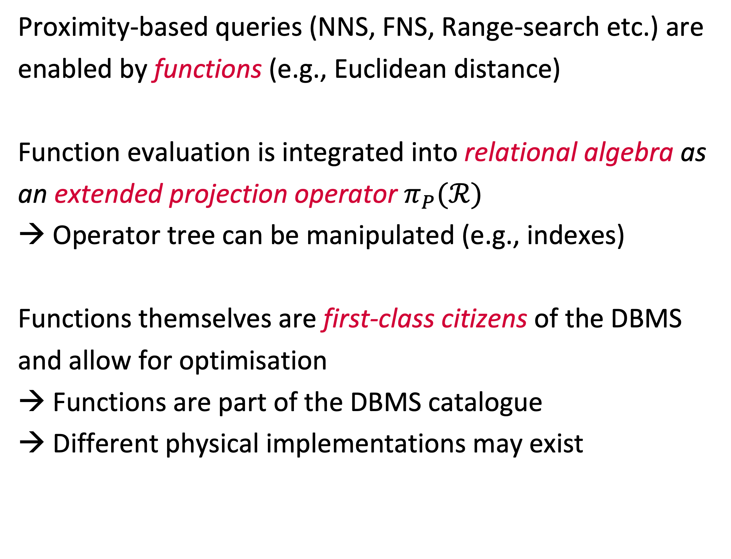
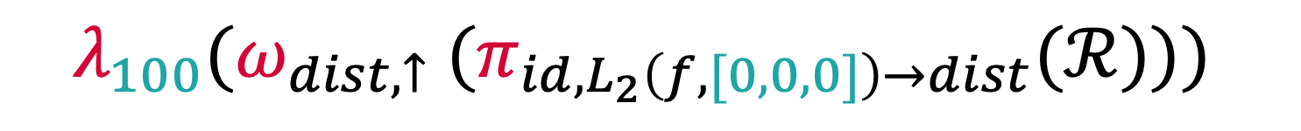
A Relational Model to Accommodate Proximity Based Queries Outline
Query
Proximity-based queries (NNS, FNS, Range-search etc.) are enabled by functions (e.g., Euclidean distance)
Function evaluation is integrated into relational algebra as an extended projection operator $π_{P}(ℛ)$
→ Operator tree can be manipulated (e.g., indexes)
Functions themselves are first-class citizens of the DBMS and allow for optimisation
Functions are part of the DBMS catalogue
Different physical implementations may exist
select id, L2(f, [0,0,0]) as distance from paintings order by distance asc limit 100
Logical
$$λ_{100}({ω_{dist,↑} (π}_{id,L_{2}\left(f, [0,0,0]\right)→dist}(ℛ)))$$
Physical
Scan
paintings
Function
$L_{2}\left(f,[0,0,0]\right)→$dist
NNS
Order
dist asc
Limit
100
Project
id,dist

Slide 11
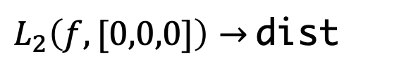
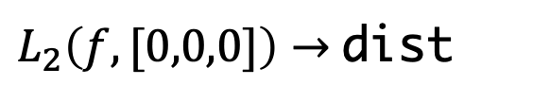
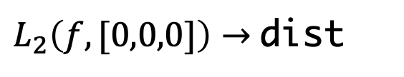
A Relational Model to Accommodate Proximity Based Queries Single Algebra, Different Queries
Nearest Neighbour Search
Farthest Neighbour
Search
Range Search
Scan
paintings
Scan
paintings
Scan
paintings
Function
$L_{2}\left(f,[0,0,0]\right)→$dist
Function
$L_{2}\left(f,[0,0,0]\right)→$dist
Function
$L_{2}\left(f,[0,0,0]\right)→$dist
Order
dist asc
Order
dist desc
Where
dist > 1.0
Limit
100
Limit
100
Order
dist asc
Project
id,dist
Project
id,dist
Project
id,dist

Slide 12
A Relational Model to Accommodate Proximity Based Queries Planning and Optimising the Query
Class 3 Index Replacement
Scan[VAF]
Project
Scan
Scan
Scalar
Function
Function
Optimised Order & Limit
Vectorised
NNS
Order
Order & Limit
Limit
Project
Scan[PQ]
Project
Class 1 Index Replacement
Order
Limit
Project
Notes:
What can a query planner do?
Index Replacement (Plan)
Replace parts of the operator tree (e.g., by index)
Thesis describes classes of index replacement operations
Index Replacement (Functions)
Function implementations

Slide 13
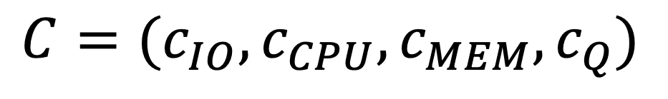
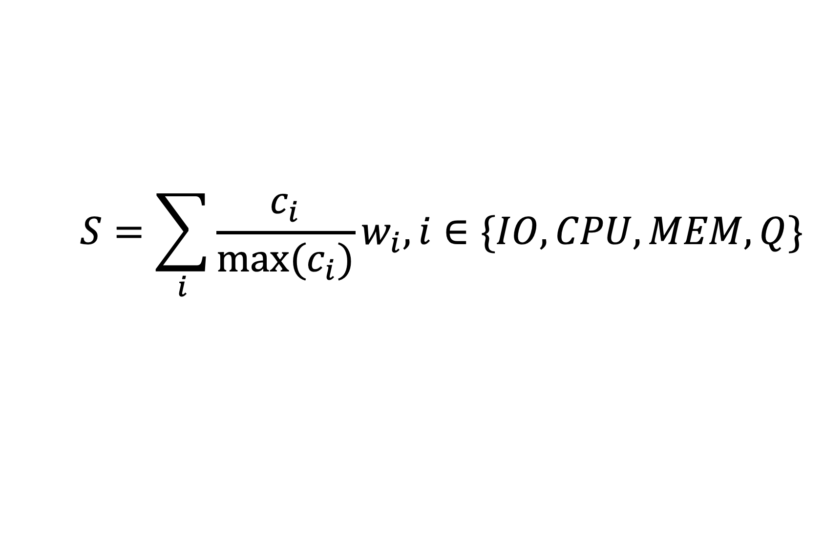
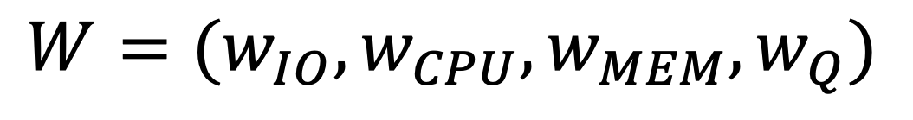
A Cost Model for Results Quality Outline
Proximity based queries often trade quality with execution time
→ High-dimensional indexes
→ Trade-off between other cost factors (e.g., CPU, IO)
DBMS must be aware of this trade-off and take it into account during query planning
→ Cost model including quality
Cost policy to express user preference
Cost
$$C=(c_{IO},c_{CPU}, c_{MEM}, c_{Q})$$
Cost Policy
$$W=(w_{IO},w_{CPU}, w_{MEM}, w_{Q})$$
Cost Score
$$S=\sum_{i}{\frac{c_{i}}{{max⁡(c}_{i})}w_{i}, i∈\{IO,CPU,MEM,Q\}}$$
Notes:
Outline:
Cost is a vector of “atomic costs”
Policy is a vector of weights
Score is the linear combination of cost & policy
--> Empirical mechanisms for estimating quality cost are described in thesis.

Slide 14
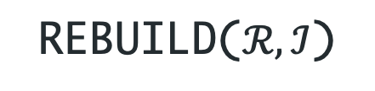



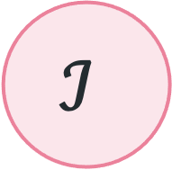


High-Dimensional Index Maintenance Outline
$$𝒞$$
Incremental changes and persistence are not systematically considered in High-Dimensional index research (with exceptions, e.g., NV-Tree [1])
We propose a system-level mechanism to be implemented per index:
A write model for the index
A failure model for the index
An explicit state w.r.t. to its availability
We also propose a non-blocking rebuild mechanism that exploits properties of snapshot isolation
$$ℐ$$
WRITEM($𝒞$)
FAILM($𝒞$)
REBUILD($ℛ,ℐ\text{)}$
CLEAN
STALE
FAILM($C$)
REBUILD($ℛ,ℐ$)
DIRTY
[1] Lejsek et al. (2008). NV-Tree: An Efficient Disk-based Index for Approximate Search in Very Large High-Dimensional Collections

Slide 15
Putting Everything Together: Cottontail DB Architecture
Multimedia Database
Column store developed in Kotlin (runs in the JVM)
Support for scalar and vector data
Boolean- and similarity search
Index support for both
Transaction support
Query model with ext. relational algebra
Cost model
Write model
Failure model
Async. index rebuild

Slide 16
Evaluation

Slide 17
Evaluation
Comparison: Milvus [1] vs. Cottontail DB
→ Goal: Test and compare performance in “big” multimedia retrieval (quality / speed)
The Effect of Data Changes on Index Performance
Goal: Test effects of data changes on indexes
Use of the Query Model in a Mixed Query Workload
→ Goal: Test effect of different execution parameters on performance (quality / speed)
[1] Wang et al. (2021). Milvus – A Purpose-Built Vector Data Management System

Slide 18




Evaluation: Big Multimedia Retrieval Overview
Setup
Yandex Deep 1B [1] dataset
96-dimensional vectors
5M, 10M, 100M, 1B shard
Single node
Experiment
Execute NNS queries with random vectors (L2)
Direct comparison to Milvus [2]
Goal
Compare latency of query execution (execution time)
Milvus
Cottontail DB
Latency
Latency
Thread 1 NNS
Yandex Deep 1B (Query set)
[1] Babenko et al. (2016). Efficient Indexing of Billion-scale Datasets of Deep Descriptors.
[2] Wang et al. (2021). Milvus – A Purpose-Built Vector Data Management System

Slide 19
Evaluation: Big Multimedia Retrieval Results
Time the query took (both plots)
Method of data access
Method of data access
Collections
Collection size

Slide 20
Evaluation: Big Multimedia Retrieval Results

Slide 21
Evaluation: Big Multimedia Retrieval What About 1 Billion Entries?
Cottontail DB was capable of performing NNS for the 1B shard, but, latency numbers were far from interactive
→ Optimisations required
Milvus could not perform the NNS query on the 1B shard, because dataset did not fit into memory (384 GB)
Milvus cannot process dataset on our a single-node setup
Size | Access Method | Latency [s]
10⁹ | SCAN | 339.82
10⁹ | VAF | 387.23
10⁹ | PQ | 65.00
Cottontail DB result on Yandex Deep 1B
Notes:
Ad Milvus
Can be seen as an argument for considering on-disk data access

Slide 22
Evaluation: High-Dimensional Index Maintenance Overview
Setup
Yandex Deep 1B [1] dataset (1M shard)
VAF (pre-built) [2]
Experiment
Thread 1: Write workload
Thread 2: NNS queries with random query vectors
brute-force & with index use
Goal
Observe speed-up as changes accumulate
Cottontail DB
Latency
Thread 1 INSERT (90%)
DELETE (10%)
Thread 2 NNS
Yandex Deep 1B
Yandex Deep 1B (Query set)
[1] Babenko et al. (2016). Efficient Indexing of Billion-scale Datasets of Deep Descriptors.
[2] Weber et al. (1998). A Quantitative Analysis and Performance Study for Similarity-Search Methods in High-Dimensional Spaces.

Slide 23
Evaluation: High-Dimensional Index Maintenance Results (VAF Index)
Speed-up gained by index
Setup:
VAF [1] index
Runtime 30min
90% INSERT / 10% DELETE
No out-of-distribution data
Size of data collection
Time elapsed (for both plots)
[1] Weber et al. (1998). A Quantitative Analysis and Performance Study for Similarity-Search Methods in High-Dimensional Spaces.

Slide 24
Evaluation: High-Dimensional Index Maintenance Results (VAF Index)
In-distribution query vectors
Setup:
VAF [1] index
Runtime 30min
90% INSERT / 10% DELETE
Out-of-distribution data
Out-of-distribution query vectors
[1] Weber et al. (1998). A Quantitative Analysis and Performance Study for Similarity-Search Methods in High-Dimensional Spaces.

Slide 25
Evaluation: High-Dimensional Index Maintenance Results (Index Rebuild / VAF Index)
Setup:
VAF [1] index
Runtime 60min
90% INSERT / 10% DELETE
Out-of-distribution data
With rebuild after 30min
Stabilised speed-up
Index rebuild
[1] Weber et al. (1998). A Quantitative Analysis and Performance Study for Similarity-Search Methods in High-Dimensional Spaces.

Slide 26
Evaluation: High-Dimensional Index Maintenance Discussion
Big Multimedia Retrieval:
Single-purpose database (Milvus) vs. general-purpose system (Cottontail DB)
Milvus faster once data has been loaded into memory
Cottontail DB competitive if data loading is taken into account (consider use-case that relies on more than one collection)
→ Cottontail DB is way more flexible (range-search, fetching of vectors etc.)
Index Adaptiveness:
Write model for VAF index capable of handling INSERT and DELETE
Index robust to changes as long as data remains in distribution
Out-of-distribution data leads to deterioration of index performance
Asynchronous rebuild is a way of handling this issue

Slide 27
Conclusion and Outlook

Slide 28
Conclusion
We introduced three models that work towards unified data management for multimedia data:
Query model to express proximity based queries (NNS, FNS, range search, etc.) in relational algebra
Cost model to express quality of query results
Write- and failure model to accommodate and maintain high-dimensional indexes
We presented an implementation in the form of Cottontail DB, which is part of a multimedia retrieval stack
→ Applicable to multimedia retrieval and multimedia analytics
We have presented an evaluation on top of Cottontail DB that demonstrates the feasibility of the models.

Slide 29
Future Work
Learning to Index
Index performance highly dependent on configuration
Finding the right hyper-parameters is a manual task
Self-adaptiveness when data is changing data
Quality in Complex Plans
Quality guarantees for indexes (upper-bounds) and simple queries
Error propagation in complex plans (e.g., JOIN, SUB-SELECT)
Extended Query Model
Fuzzy operations (e.g., similarity joins)
More advanced paradigms (RNNS)
Index support for new query methods
Quality vs. Time Trade-off
Interactive control over quality vs. execution time (e.g., early abort)
Combination with progressive queries possible (work of Giangreco et al.)

Slide 30
Thank you!
Questions?
Ralph Gasser
ralph.gasser@unibas.ch
Databases and Information Systems (DBIS) Group, Department of Mathematics and Computer Science, University of Basel

Slide 31
Backup Slides (Definitions)

Slide 32
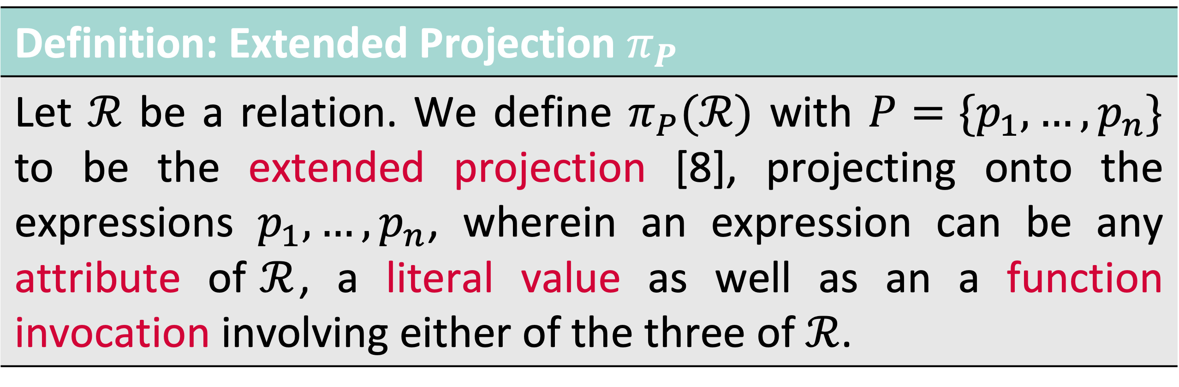
Relational Algebra Extensions Extended Projection
Definition: Extended Projection $π_{P}$
Let $ℛ$ be a relation. We define $π_{P}(ℛ)$ with $P=\{p_{1},…,p_{n}\}$ to be the extended projection [8], projecting onto the expressions $p_{1},…,p_{n}$, wherein an expression can be any attribute of$ℛ$, a literal value as well as an a function invocation involving either of the three of $ℛ$.
Observation #1: Projection may involve evaluation of a distance function → We call this a proximity based query
Observation #2: Domain of a function is an implicit extended projection
→ Functions can be nested

Slide 33
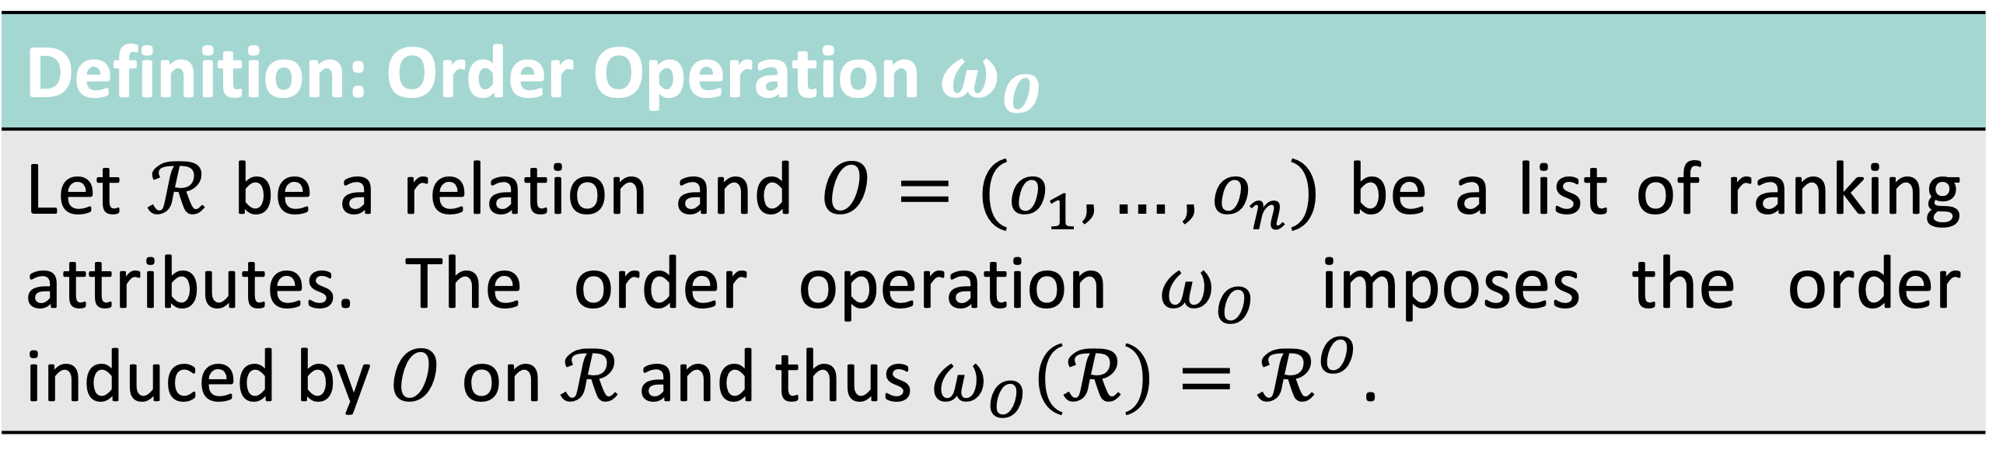
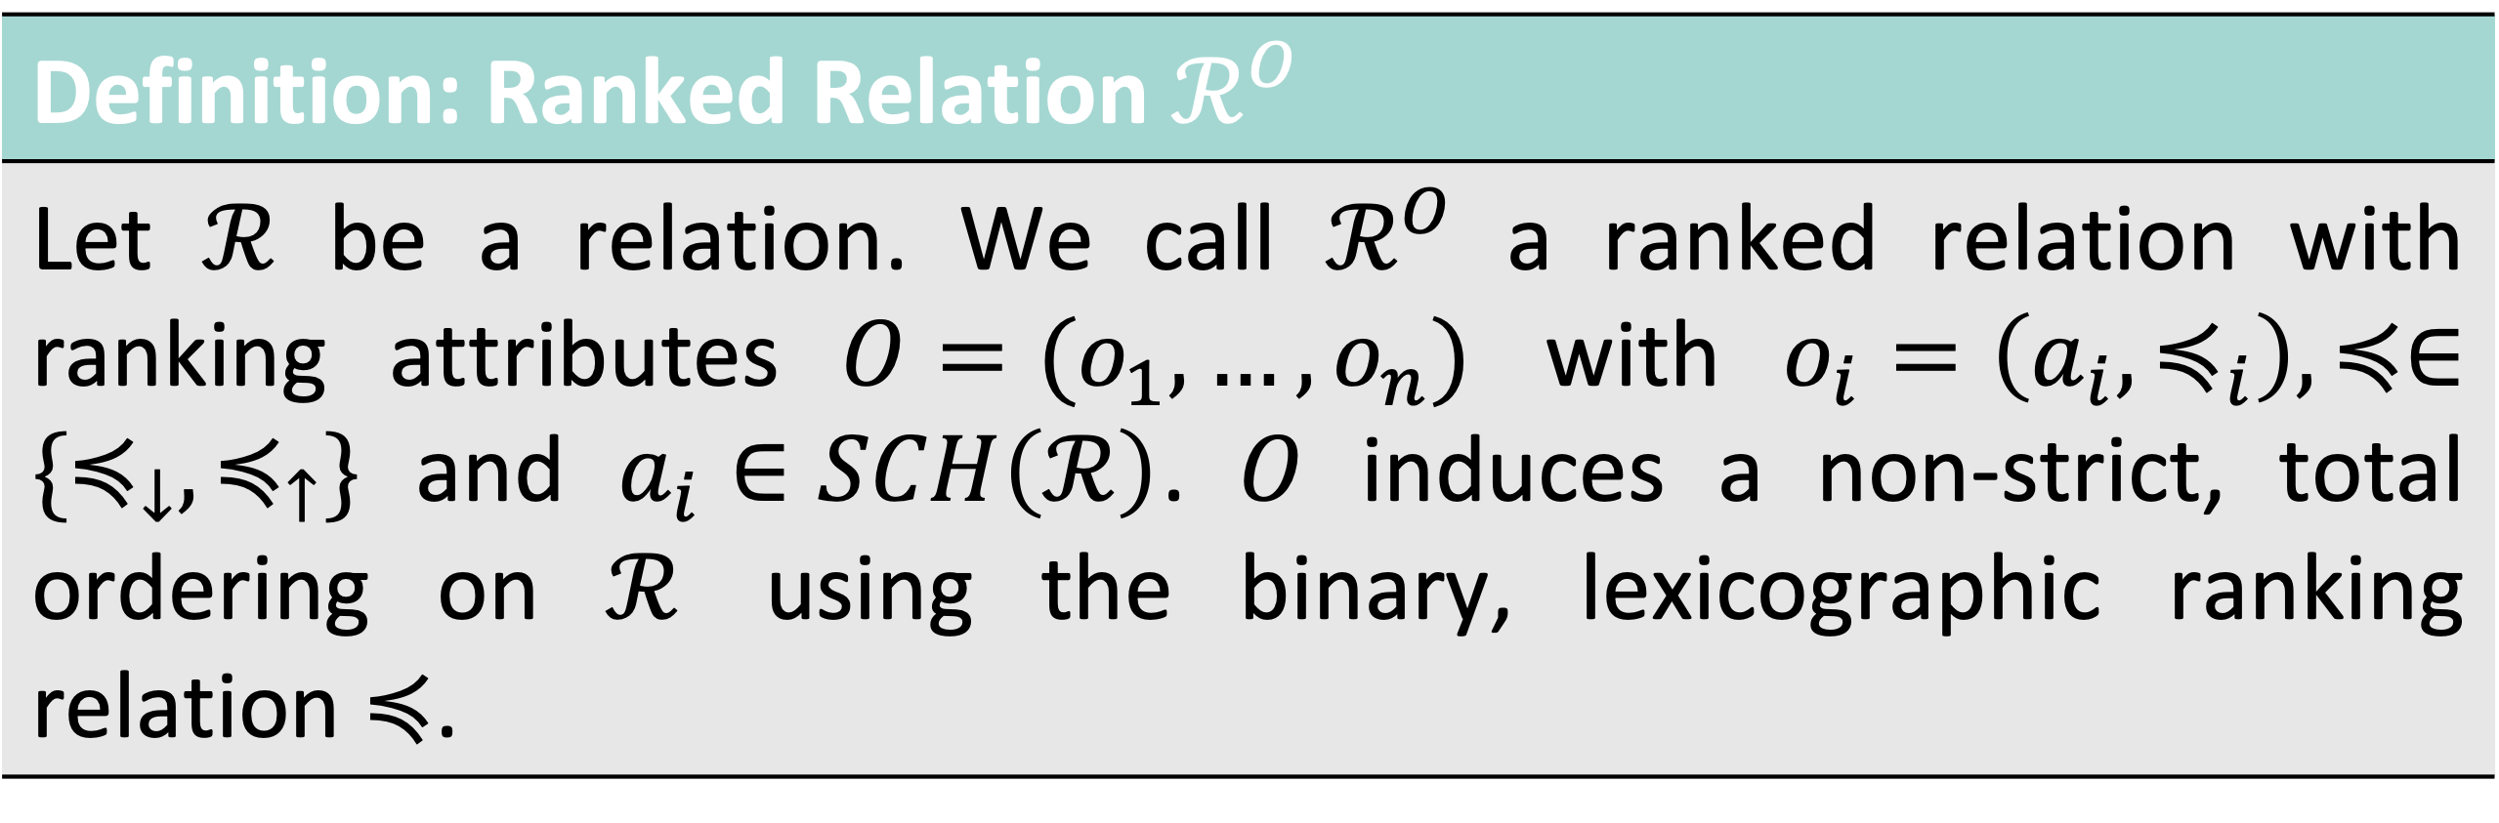
Relational Algebra Extensions Ranked Relations and Order
Definition: Ranked Relation $ℛ^{O}$
Let $ℛ$ be a relation. We call $ℛ^{O}$ a ranked relation with ranking attributes $O=(o_{1},…,o_{n})$ with $o_{i}=\left(a_{i},≼_{i}\right), ≼∈\{≼_{↓},≼_{↑}\}$ and $a_{i}∈SCH\left(ℛ\right)$. $O$ induces a non-strict, total ordering on $ℛ$ using the binary, lexicographic ranking relation $≼$.
Definition: Order Operation $ω_{O}$
Let $ℛ$ be a relation and $O=(o_{1},…,o_{n})$ be a list of ranking attributes. The order operation $ω_{O}$ imposes the order induced by $O$ on $ℛ$ and thus $ω_{O}\left(ℛ\right)=ℛ^{O}$.

Slide 34
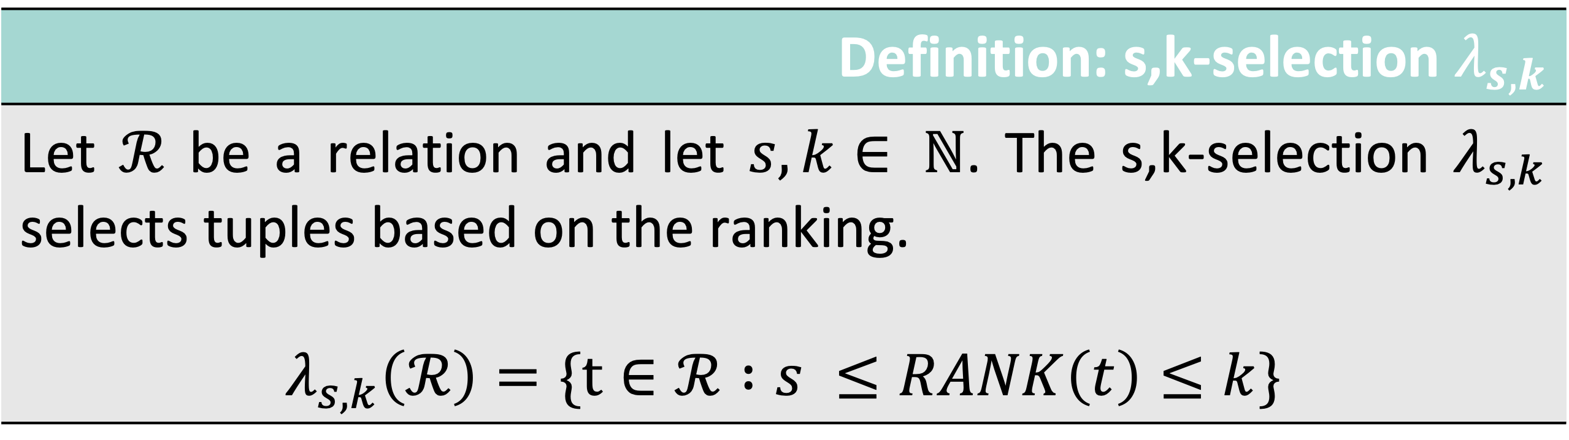
Relational Algebra s,k-selection
Definition: s,k-selection $λ_{s,k}$
Let $ℛ$ be a relation and let $s,k∈ ℕ$. The s,k-selection $λ_{s,k}$ selects tuples based on the ranking. $$λ_{s,k}\left(ℛ\right)=\{t∈ℛ :s ≤RANK\left(t\right)≤k\}$$

Slide 35
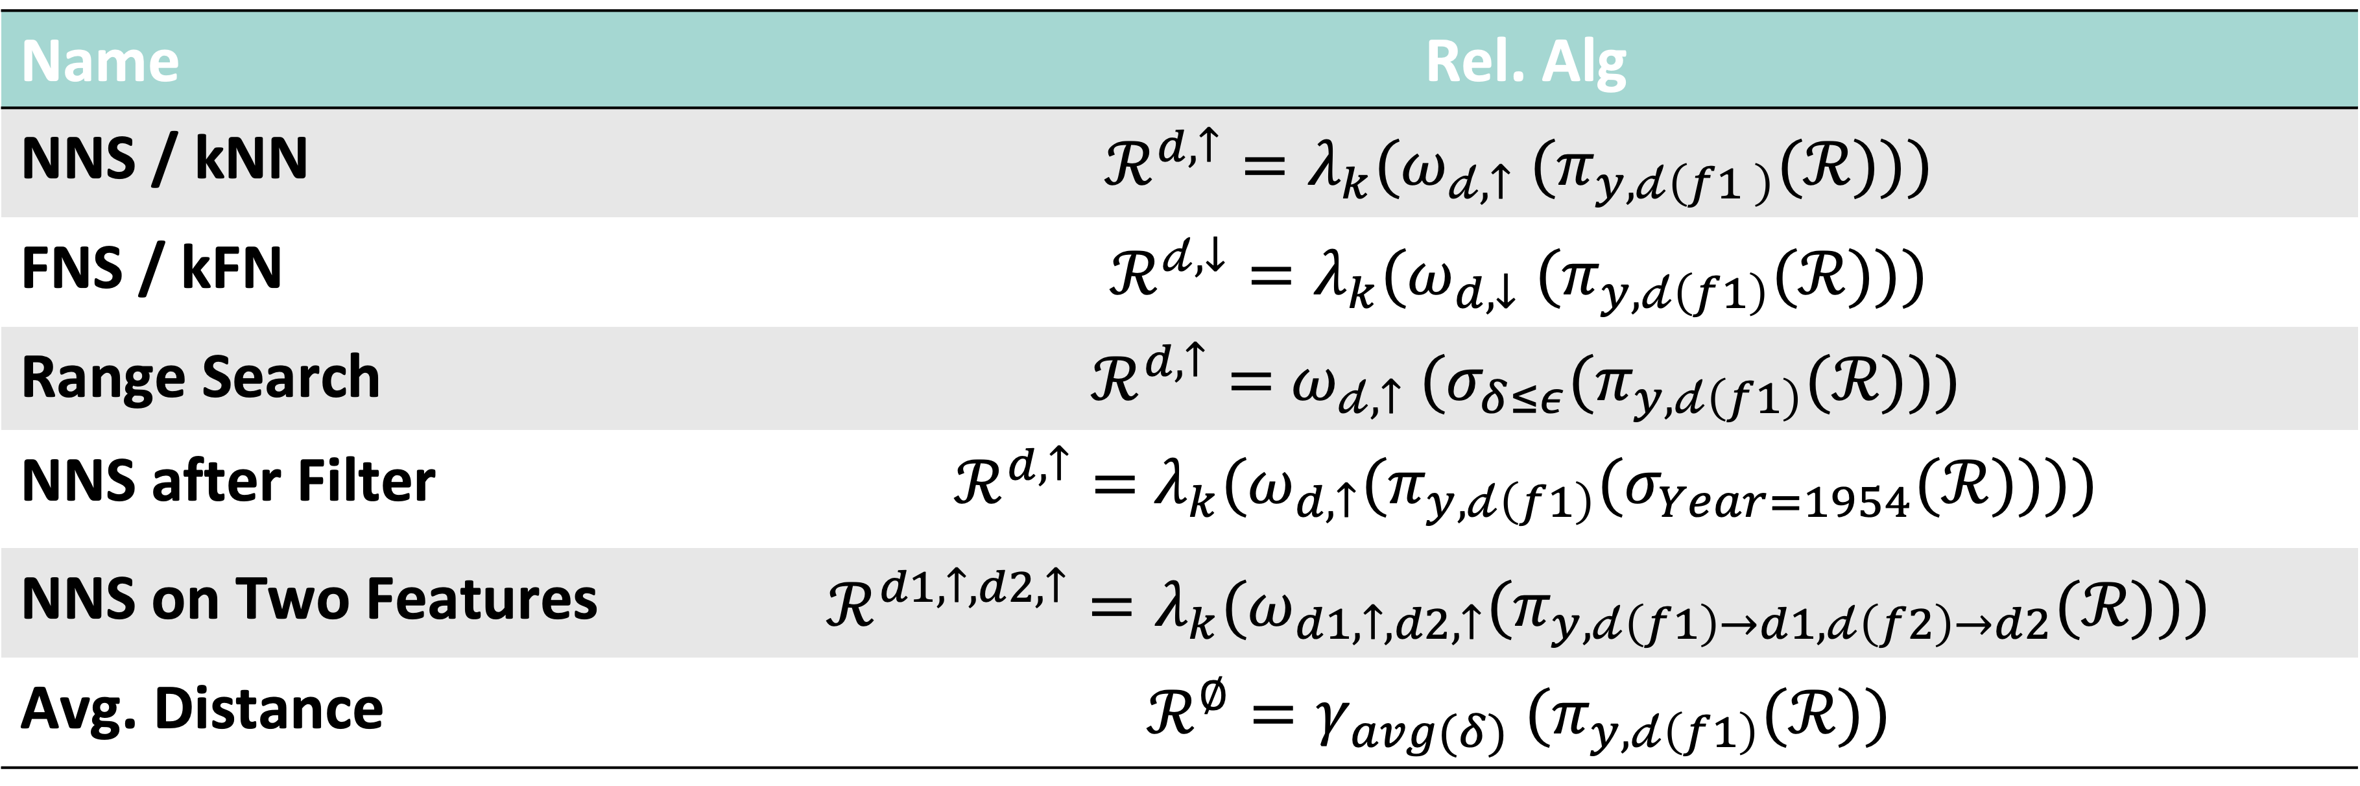
Expressing Proximity Based Queries
Name | Rel. Alg
NNS / kNN | $${ℛ^{d,↑}=λ}_{k}({ω_{𝒹,↑} (π}_{y,𝒹\left(f1 \right)}(ℛ)))$$
FNS / kFN | $$ℛ^{𝒹,↓}=λ_{k}({ω_{d,↓} (π}_{y,𝒹\left(f1\right)}(ℛ)))$$
Range Search | $ℛ^{d,↑}=$ ${ω_{𝒹,↑} (σ_{δ≤ε}(π}_{y,𝒹\left(f1\right)}(ℛ)))$
NNS after Filter | $ℛ^{d,↑}=$ ${{λ_{k}(ω}_{d,↑}(π}_{y,𝒹\left(f1\right)}(σ_{Year=1954}(ℛ))))$
NNS on Two Features | $${ℛ^{d1,↑,d2,↑}={λ_{k}(ω}_{d1,↑,d2,↑}(π}_{y,𝒹\left(f1\right)→d1,𝒹\left(f2\right)→d2}(ℛ)))$$
Avg. Distance | $${{ℛ^{∅}=γ}_{avg(δ)} (π}_{y,𝒹\left(f1\right)}(ℛ))$$

Slide 36
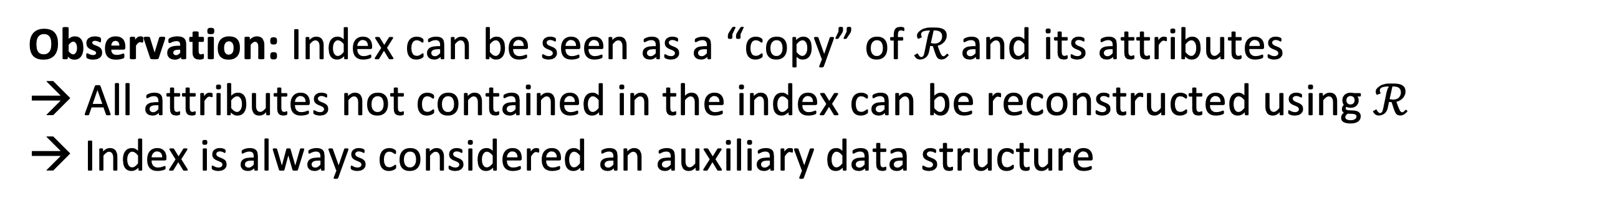
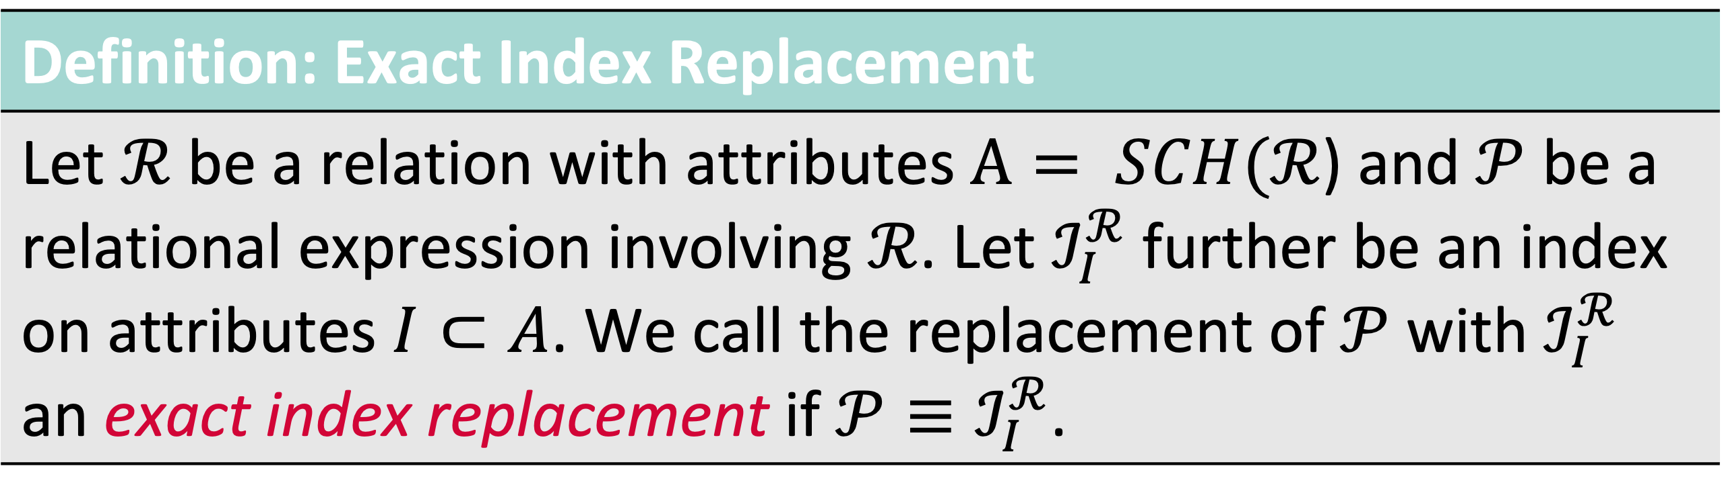
High-Dimensional Indexes and Rel. Alg. Extension
Definition: Exact Index Replacement
Let $ℛ$ be a relation with attributes $A= SCH(ℛ$) and $𝒫$ be a relational expression involving $ℛ$. Let $ℐ_{I}^{ℛ}$ further be an index on attributes $I⊂A$. We call the replacement of $𝒫$ with $ℐ_{I}^{ℛ}$ an exact index replacement if $𝒫≡ℐ_{I}^{ℛ}$.
Observation: Index can be seen as a “copy” of $ℛ$ and its attributes → All attributes not contained in the index can be reconstructed using $ℛ$
→ Index is always considered an auxiliary data structure
$$ℐ_{I}^{ℛ}⋈_{TID}π_{A}\left(ℛ\right), A=\{a:a∈SCH\left(ℛ\right) ∧a∉SCH\left(ℐ_{I}^{ℛ}\right)\}$$
“Fetch”

Slide 37
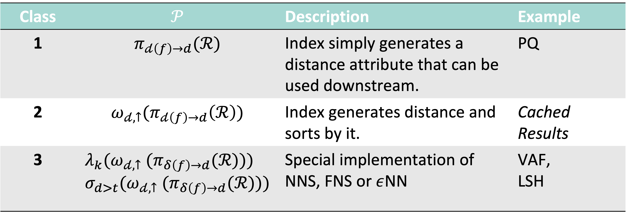
High-Dimensional Indexes and Rel. Alg. Extension
Class | $$𝒫$$ | Description | Example
1 | $$π_{𝒹\left(f\right)→d}(ℛ)$$ | Index simply generates a distance attribute that can be used downstream. | PQ
2 | $$ω_{𝒹,↑}(π_{𝒹\left(f\right)→d}\left(ℛ\right))$$ | Index generates distance and sorts by it. | Cached Results
3 | $$λ_{k}({ω_{𝒹,↑} (π}_{δ\left(f\right)→d}(ℛ))) \\ σ_{d>t}({ω_{𝒹,↑} (π}_{δ\left(f\right)→d}(ℛ)))$$ | Special implementation of NNS, FNS or $ε$NN | VAF, LSH

Slide 38
A Relational Model to Accommodate Proximity Based Queries Planning and Optimisation using Indexes
Class 1
Class 2
Class 3
Scan
Scan
Scan
Function
Function
Function
Order
Order
Limit
Index ”replaces” function execution.
Example: PQ [1]
Index can replace function execution and induces order.
Example: Cached Results
Index covers a specific edge case (e.g., NNS, FNS).
Example: VAF [2]
[1] Jégou et al. (2011). Product Quantization for Nearest Neighbor Search.
[2] Weber et al. (1998). A Quantitative Analysis and Performance Study for Similarity-Search Methods in High-Dimensional Spaces.
Notes:
Idea of replacement classes:
Type of operators that can be replaced by an index.

Slide 39


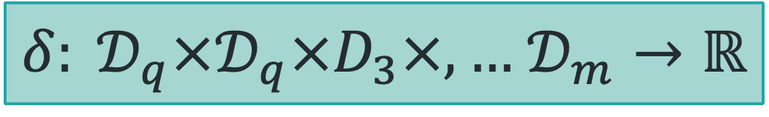
A Relational Model to Accommodate Proximity Based Queries Planning and Optimising on a Function Level
General Function
$$f:𝒟_{1}×,…,𝒟_{m}→𝒟$$
Any function known to the DBMS
(function registry).
Distance Function Class
$δ: 𝒟_{q}×𝒟_{q}×D_{3}×,…$ $𝒟_{m}→ℝ$
A distance function that can be used to
compare vectors.
Query Context
A logical implementation of a distance function (e.g., certain arguments become constants)
Logical Implementation
$$δ:𝒟_{q}→ ℝ$$
Physical Implementation
Scalar
Vectorised
GPU
A physical implementation of a distance function (e.g., executed as a SIMD optimised version)

Slide 40
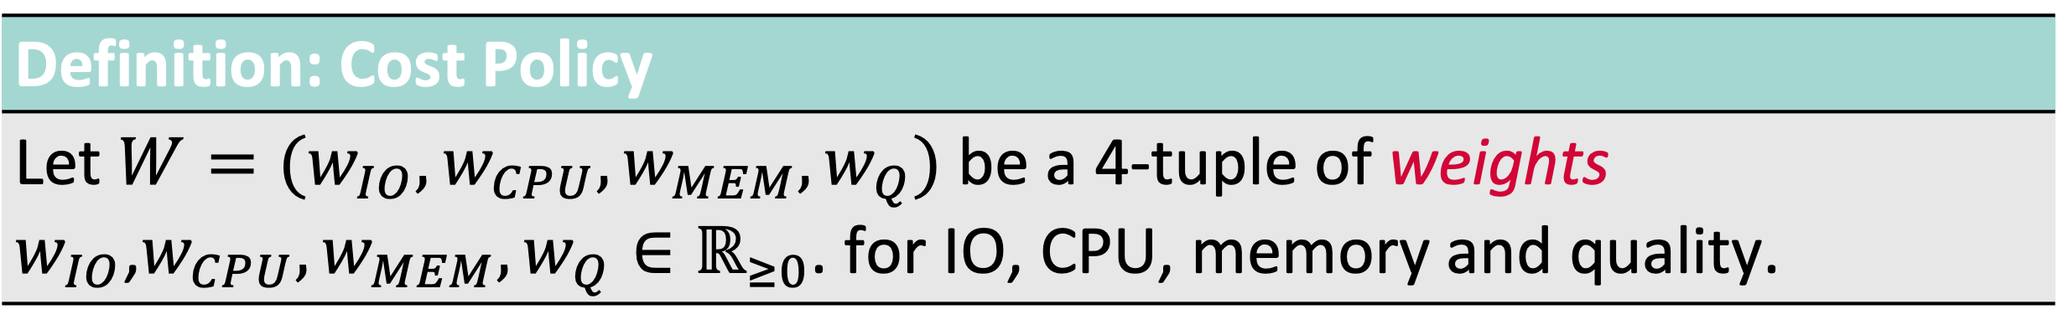
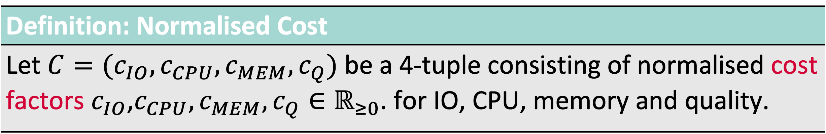
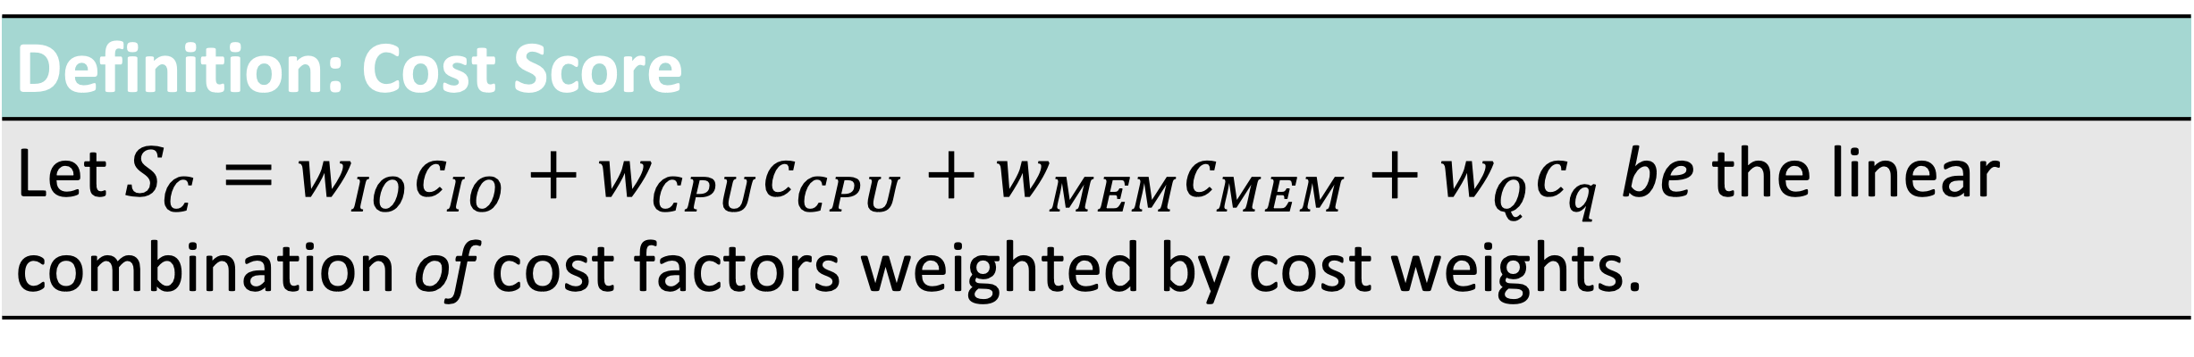
Cost Model Overview
Definition: Normalised Cost
Let $C=(c_{IO}, c_{CPU}, c_{MEM}, c_{Q})$ be a 4-tuple consisting of normalised cost factors $c_{IO}$,$c_{CPU}, c_{MEM}, c_{Q}∈ℝ_{≥0}$. for IO, CPU, memory and quality.
Definition: Cost Policy
Let $W=(w_{IO}, w_{CPU}, w_{MEM}, w_{Q})$ be a 4-tuple of weights $w_{IO}$,$w_{CPU}, w_{MEM}, w_{Q}∈ℝ_{≥0}$. for IO, CPU, memory and quality.
Definition: Cost Score
Let $S_{C}=w_{IO}c_{IO}+w_{CPU}c_{CPU}+w_{MEM}c_{MEM}+w_{Q}c_{q}$ be the linear combination of cost factors weighted by cost weights.

Slide 41

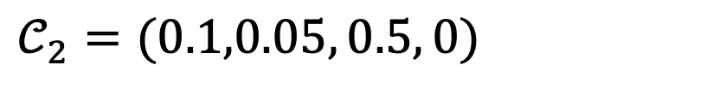


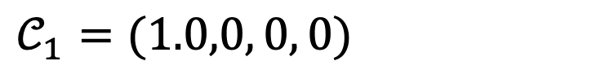
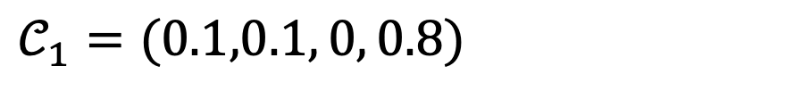


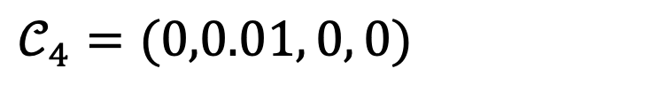
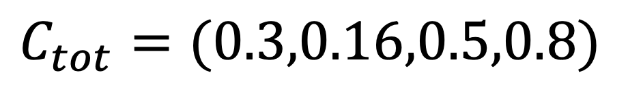
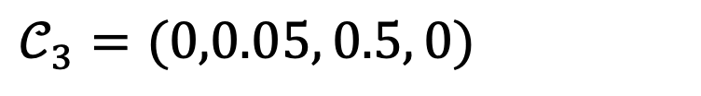
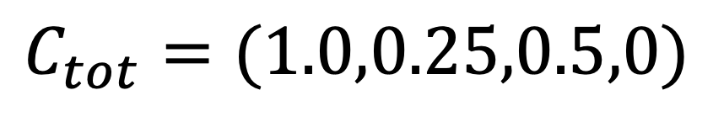
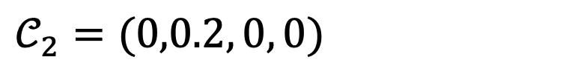
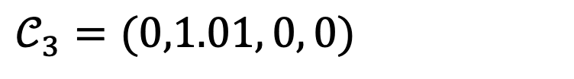

A Cost Model for Results Quality Comparing Two Execution Plans
Scan
$$𝒞_{1}=(1.0,0, 0, 0)$$
Scan[PQ]
$$𝒞_{1}=(0.1,0.1, 0, 0.8)$$
Function
$$𝒞_{2}=(0,0.2, 0, 0)$$
Order & Limit
$$𝒞_{2}=(0.1,0.05, 0.5, 0)$$
Order & Limit
$$𝒞_{3}=(0,0.05, 0.5, 0)$$
Project
$$𝒞_{3}=(0,1.01, 0, 0)$$
Project
$$𝒞_{4}=(0,0.01, 0, 0)$$
$$C_{tot}=(1.0,0.25,0.5,0)$$
$$C_{tot}=(0.3,0.16,0.5,0.8)$$
$$W=(1,0, 0,1)$$
$$W=(1,0, 0, 0)$$
$$S=1.0$$
$$S=0.3$$
$$S=1.1$$

Slide 42
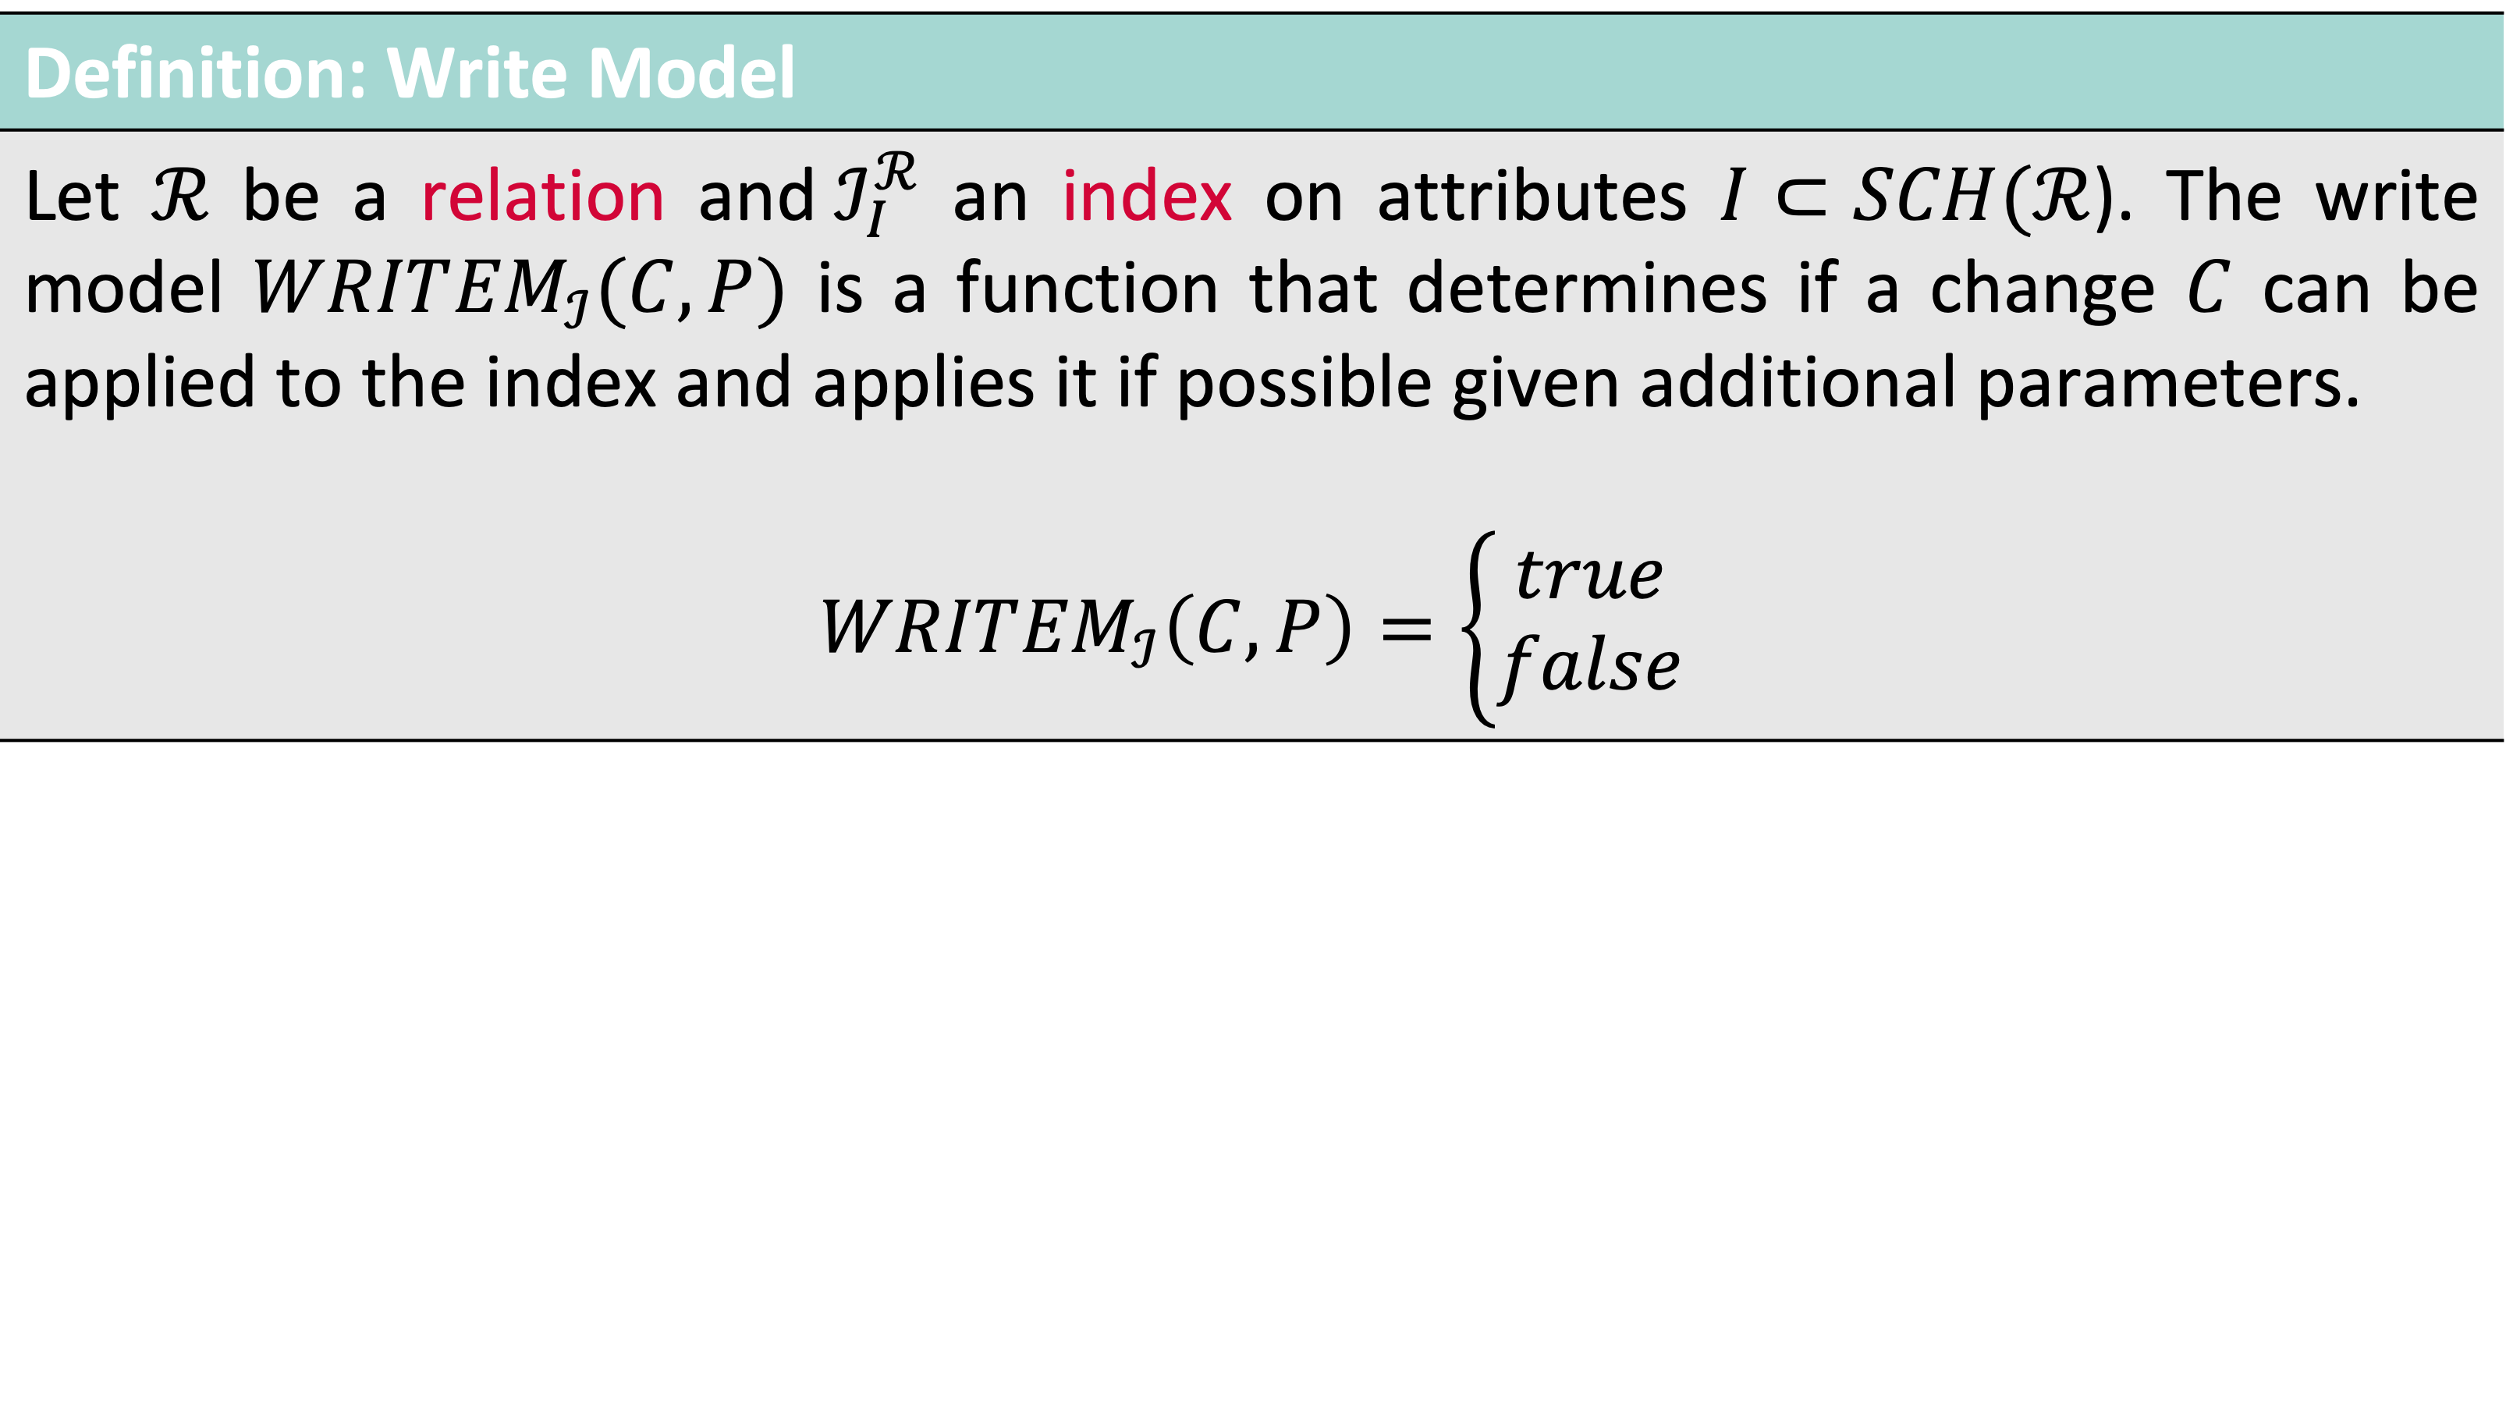
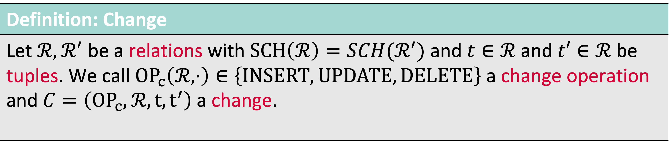
Write Model of an Index
Definition: Change
Let $ℛ,ℛ^{′}$ be a relations with $SCH\left(ℛ\right)=SCH(ℛ^{′})$ and $t∈ℛ$ and $t′∈ℛ$ be tuples. We call ${OP}_{c}\left(ℛ, ⋅\right)∈\left\{INSERT, UPDATE, DELETE\right\}$ a change operation and $C=\left({OP}_{c},ℛ,t,t^{′}\right)$a change.
Definition: Write Model
Let $ℛ$ be a relation and${ ℐ}_{I}^{ℛ}$ an index on attributes $I⊂SCH(ℛ$). The write model $WRIT{EM}_{ℐ}(C,P)$ is a function that determines if a change $C$ can be applied to the index and applies it if possible given additional parameters. $$WRIT{EM}_{ℐ}\left(C,P\right)=\left\{\begin{aligned}true \\ false\end{aligned}\right.$$

Slide 43
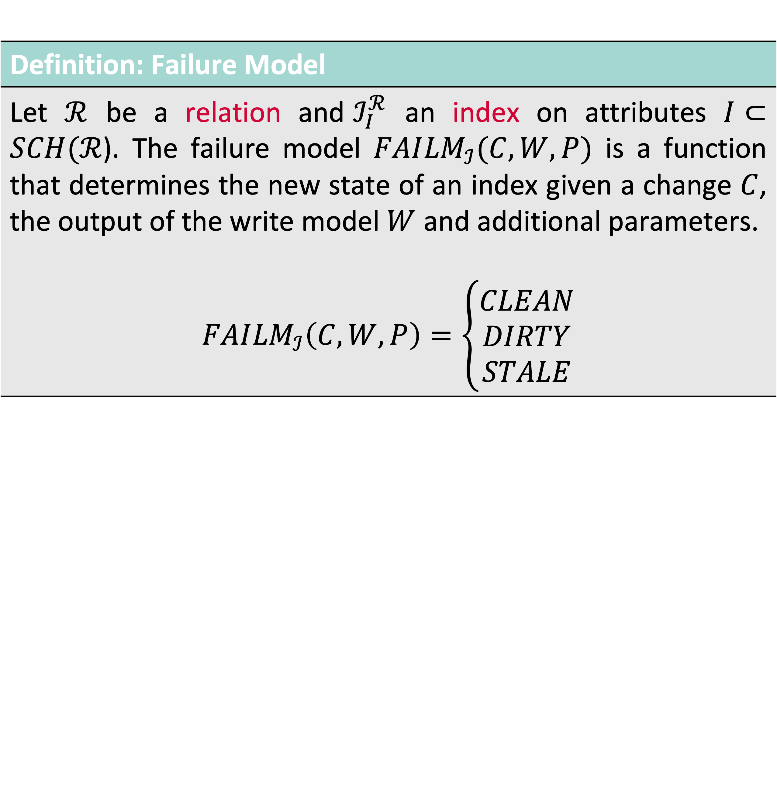
Failure Model and State of an Index
Definition: Failure Model
Let $ℛ$ be a relation and${ ℐ}_{I}^{ℛ}$ an index on attributes $I⊂SCH(ℛ$). The failure model $FAI{LM}_{ℐ}(C,W,P)$ is a function that determines the new state of an index given a change $C$, the output of the write model $W$ and additional parameters. $$FAI{LM}_{ℐ}\left(C,W,P\right)=\left\{\begin{aligned}CLEAN \\ DIRTY \\ STALE\end{aligned}\right.$$

Slide 44

High-Dimensional Index Maintenance Example: Write Model for a VA file [1]
$𝖙$( ) = = $\left({0.57 \atop \begin{aligned}0.82 \\ 0.32\end{aligned}}\right)$
= ?
= 22
Feature transformation
$$𝕆→ 𝔽$$
10
How does VAF work:
Partition vector space to create lattic (usually by component-wise min/max)
Assign every vector to cell in lattice
Store resulting signature
Upon scan, distance can be approximated and entry can be filtered (save CPU / IO)
Upon Insert / Update:
If point falls within grid → write signature
If point is out of bounds → issue
9
8
7
6
5
4
3
2
1
1
2
3
4
5
6
7
8
9
10
11

Slide 45
Backup Slides (Evaluation)

Slide 46
Evaluation: Milvus vs. Cottontail DB Results: Cottontail DB

Slide 47
Evaluation: Milvus vs. Cottontail DB Results: Milvus

Slide 48
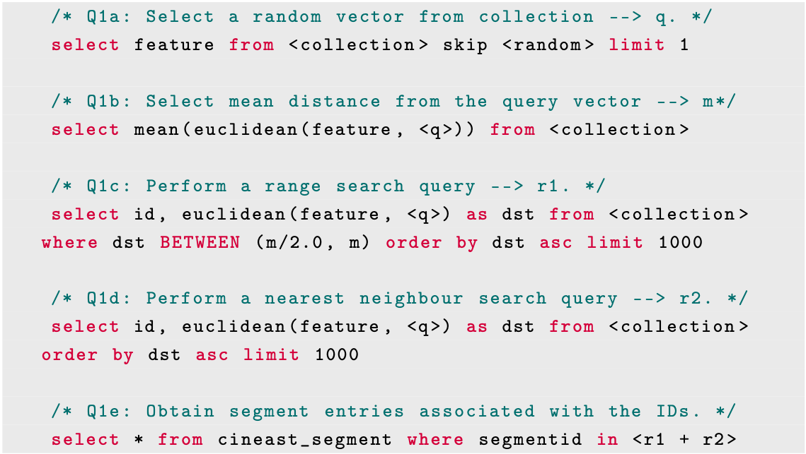
Evaluation: Query Model
Evaluation Setup
V3C [1] Dataset (different entities)
VAF & PQ-Index (pre-built) [2]
Mixed Query Workload (Q1a-Q1e)
Settings via query hint
Measurements:
Score & rank of different plan alternatives
What query plan gets selected

Slide 49
Evaluation: Query Model Quality of Index Structures
Nearest Neighbour Search: select id, L2(f, [0,0,0]) as distance from paintings order by distance asc limit 100
Range Search: select id, L2(f, [0,0,0]) as distance from paintings where distance between <x>,<y> order by distance

Slide 50
Evaluation: The Effect of Changing Data Results (PQ Index)
Configuration:
PQ index [1]
Runtime 30min
90% Insert / 10% Delete
No out-of-distribution data
[1] Jégou et al. (2011). Product Quantization for Nearest Neighbor Search.

Slide 51
Evaluation: The Effect of Changing Data Results (PQ Index)
Configuration:
PQ index [1]
Runtime 60min
Index rebuild after 30 min
90% Insert / 10% Delete
Out-of-distribution data
[1] Jégou et al. (2011). Product Quantization for Nearest Neighbor Search.

Slide 52
Evaluation: Mixed Multimedia Analytics Results

Slide 53
Evaluation: Query Model and the Effect of Cost Results
Proximity Based Query: select mean(L2(f, [0,0,0])) from paintings
Notes:
Available Indexes:
PQ and VAF / VAF cannot be used (class 3)
P2 vs P3 / Remove superfluous columns

Slide 54
Evaluation: Query Model and the Effect of Cost Results
Proximity Based Query: select id, L2(f, [0,0,0]) as distance from paintings order by distance asc limit 100
Notes:
Available Indexes:
PQ and VAF / VAF can be used (class 1)
P1 vs P2 / Fetch after Limit

